Slide 1
ELECTROMAGNETIC THEORY
UNIT-1

Slide 2
Unit-1
Introduction to various Co-ordinate Systems- Sources and effects of electromagnetic fields- Divergence theorem-Strokes theorem- Field theory and circuit theory comparison- Electric field intensity-Electric fields due to point, line, surface and volume charge distributions – Electric flux density- Coulomb’s law -Introduction to magnetic circuits – Magnetically induced EMF and Mechanical force, torque calculations-Magnetic field in a rotating machine-generated voltage –induced EMF

Slide 3
INTRODUCTION
Electromagnetics is the study of interaction between the electric charges at rest and in motion.
Electromagnetic is important b’cos it provides on real world,3D understanding of electricity and magnetism .
Electric and magnetic fields forms a bridge from circuit theory, tr.lines, waves to wireless systems.
Circuit Theory treats resistors, capacitors and inductors as 2 terminal devices connected through wires.
Field theory deals with space inside and outside these devices, providing a 3D real world understanding of how they work.
Most of the energy flows outside the conductor of tr. Lines rather than inside as postulated by circuit theory.
APPLICATION:
Microwave , antennas, electric machines , satellite communication, bioelectromagnetics ,plasma ,nuclear research , fiber optics, radar metrology, remote sensing.
DEVICES : transformers , relays , radio/TV, telephones, electric motors, tr.lines , wave guides, antenna s, optic fibres radars and laser.

Slide 4
Comparison of field theory with circuit theory
 | CIRCUIT THEORY | FIELD THEORY
1 2 3 4 5 6 7 8 | This analysis originated by its own Applicable for portion of RF range The parameters I & V directly obtained from the circuit Parameters of medium are not involved Laplace transform is used Z,Y,H parameters used. It involves low power 2D Frequency is used as reference Lumped components | Evolved from tr. Theory Beyond RF range(microwave) Obtained through E & H Parameters of medium like permitivity and permeability are involved Maxwell equation is used S parameter is used. It involves high power 3D Wavelength is used Distributed parameter

Slide 5
Review of Vector Analysis
Vector analysis is a mathematical tool with which
electromagnetic (EM) concepts are most conveniently
expressed and best comprehended.
A quantity is called a scalar if it has only magnitude (e.g.,
mass, temperature, electric potential, population).
A quantity is called a vector if it has both magnitude and
direction (e.g., velocity, force, electric field intensity).
The magnitude of a vector is a scalar written as A or

Slide 6

Review of Vector Analysis
A unit vector along is defined as a vector whose
magnitude is unity (that is,1) and its direction is along
Thus
which completely specifies in terms of A and its direction

Slide 7
The Radius Vector
Review of Vector Analysis
A point P in Cartesian coordinates may be represented by
specifying (x, y, z). The radius vector (or position vector) of
point P is defined as the directed distance from the origin O
to P; that is,
The unit vector in the direction of r is

Slide 8
Vector Algebra
Review of Vector Analysis
Two vectors and can be added together to give
another vector ; that is ,
Vectors are added by adding their individual components.
Thus, if and

Slide 9
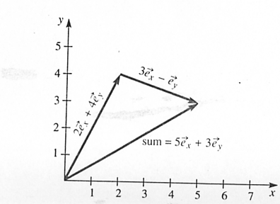
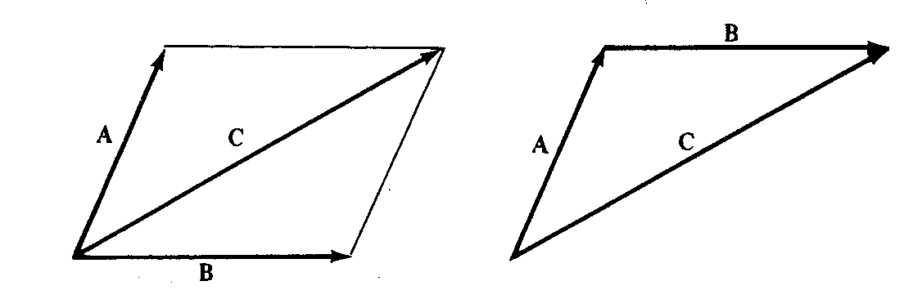
Review of Vector Analysis
Parallelogram Head to rule tail rule
Vector subtraction is similarly carried out as

Slide 10
Review of Vector Analysis
The three basic laws of algebra obeyed by any given vector
A, B, and C, are summarized as follows:
Law Addition Multiplication
Commutative
Associative
Distributive
where k and l are scalars

Slide 11
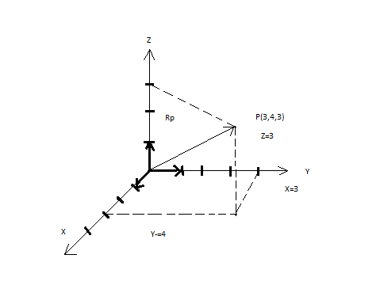
POSITION VECTOR AND DISTANCE VECTOR

Slide 12
Review of Vector Analysis
When two vectors and are multiplied, the result is
either a scalar or a vector depending on how they are
multiplied. There are two types of vector multiplication:
1. Scalar (or dot) product:
2.Vector (or cross) product:
The dot product of the two vectors and is defined
geometrically as the product of the magnitude of and the
projection of onto (or vice versa):
where is the smaller angle between and

Slide 13
Review of Vector Analysis
If and then
which is obtained by multiplying and component by
component

Slide 14
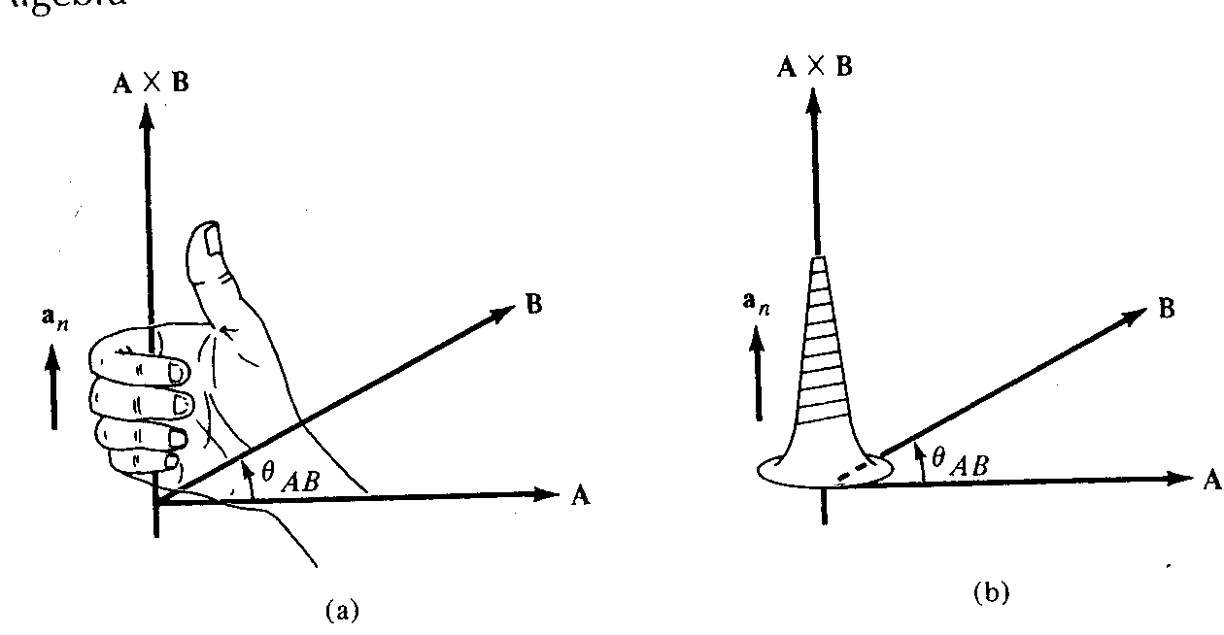
Review of Vector Analysis
The cross product of two vectors and is defined as
where is a unit vector normal to the plane containing
and . The direction of is determined using the right-
hand rule or the right-handed screw rule.
Direction of
and using
(a) right-hand rule,
(b) right-handed
screw rule

Slide 15
Review of Vector Analysis
If and then

Slide 16
Review of Vector Analysis
Note that the cross product has the following basic
properties:
(i) It is not commutative:
It is anticommutative:
(ii) It is not associative:
(iii) It is distributive:
(iv)

Slide 17
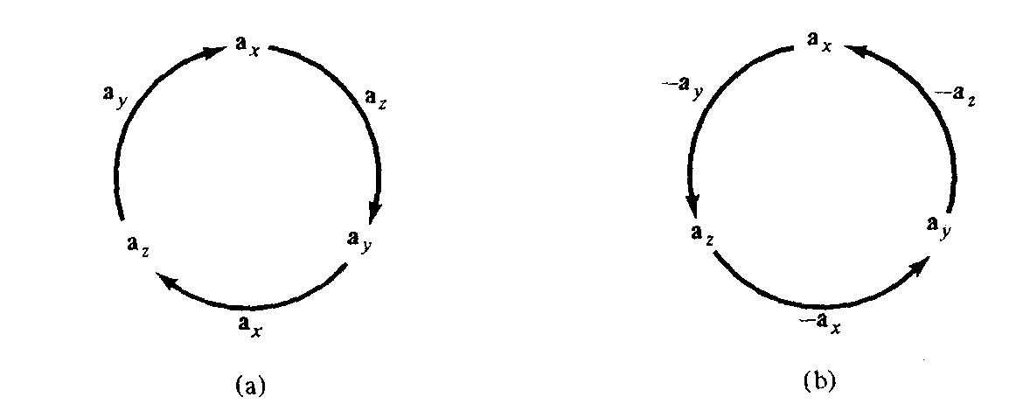
Review of Vector Analysis
Also note that
which are obtained in cyclic permutation and illustrated
below.
Cross product using cyclic permutation: (a) moving clockwise leads to positive results;
(b) moving counterclockwise leads to negative results

Slide 18
Review of Vector Analysis
Scalar and Vector Fields
A field can be defined as a function that specifies a particular
quantity everywhere in a region (e.g., temperature
distribution in a building), or as a spatial distribution of a
quantity, which may or may not be a function of time.
Scalar quantity scalar function of position scalar field
Vector quantity vector function of position vector field

Slide 19
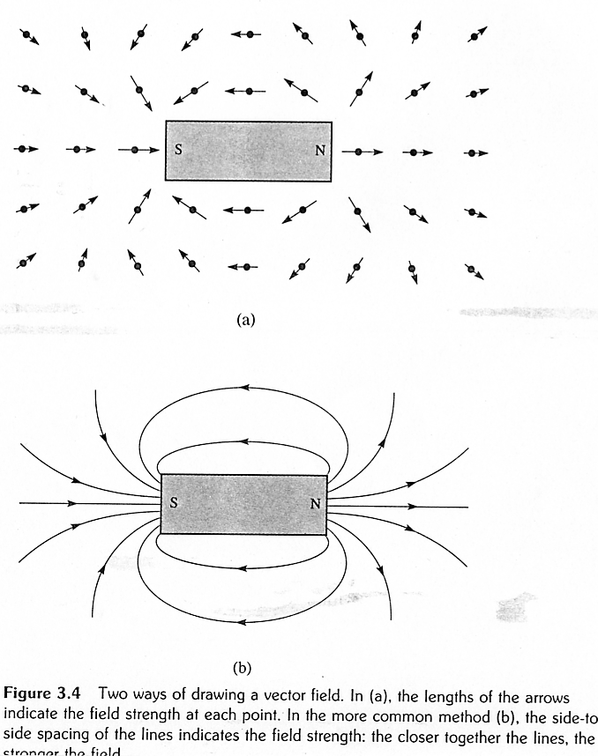
Review of Vector Analysis

Slide 20
Review of Vector Analysis
Introduction to Differential Operators
An operator acts on a vector field at a point to produce
some function of the vector field. It is like a function of a
function.
If ”O” is an operator acting on a function f(x) of the single
variable X , the result is written O[f(x)].
An operator acting on a vector field can produce
either a scalar or a vector.

Slide 21
Review of Vector Analysis
Vector fields are often specified in terms of their rectangular
components:
where , , and are three scalar features functions of
position. Operators can then be specified in terms of ,
, and .
The divergence operator is defined as

Slide 22
Review of Vector Analysis
Example . Evaluate at the
point x=1, y=-1, z=2.
Clearly the divergence operator is a scalar operator.

Slide 23
Review of Vector Analysis
1. - gradient, acts on a scalar to produce a vector
2. - divergence, acts on a vector to produce a scalar
3. - curl, acts on a vector to produce a vector
4. -Laplacian, acts on a scalar to produce a scalar
Each of these will be defined in detail in the subsequent
sections.

Slide 24
Divergence operator in cylindrical and spherical co-ordinate system.

Slide 25
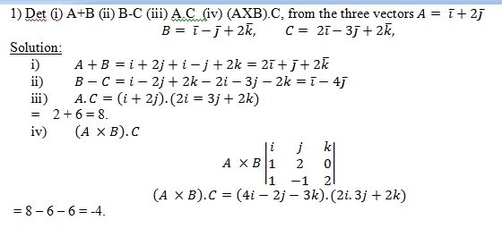

Slide 26
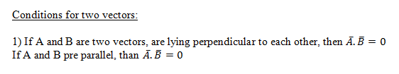
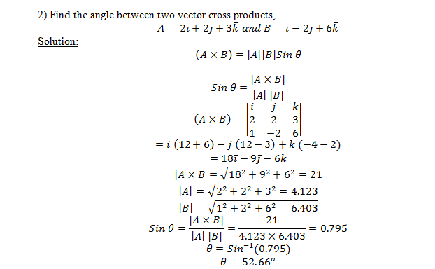

Slide 27
Coordinate Systems
In order to define the position of a point in space, an
appropriate coordinate system is needed. A considerable
amount of work and time may be saved by choosing a
coordinate system that best fits a given problem. A hard
problem in one coordinate system may turn out to be easy
in another system.
We will consider the Cartesian, the circular cylindrical, and the spherical coordinate systems. All three are orthogonal(the coordinates are mutually perpendicular).

Slide 28
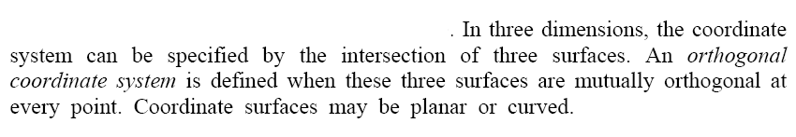
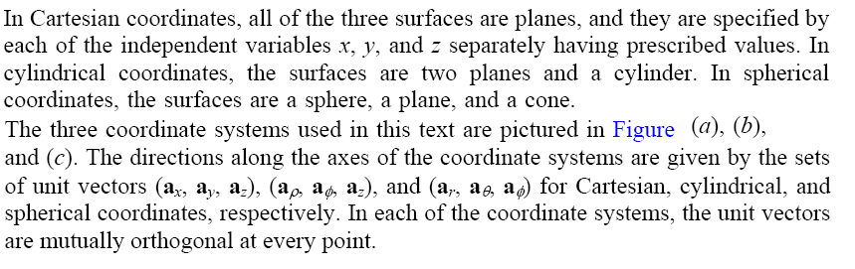

Slide 29
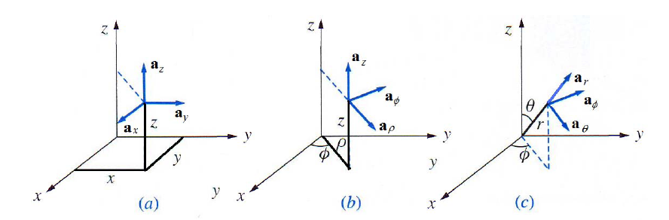

Slide 30

Cylindrical Coordinates :
- the radial distance from the z – axis
- the azimuthal angle, measured from the x- axis in the xy – plane
- the same as in the Cartesian system.
Cartesian (x,y,z):

Slide 31
Spherical coordinates .
- the distance from the origin to the point P
- the angle between the z-axis and the radius
vector of P
- the same as the azimuthal angle in cylindrical coordinates

Slide 32
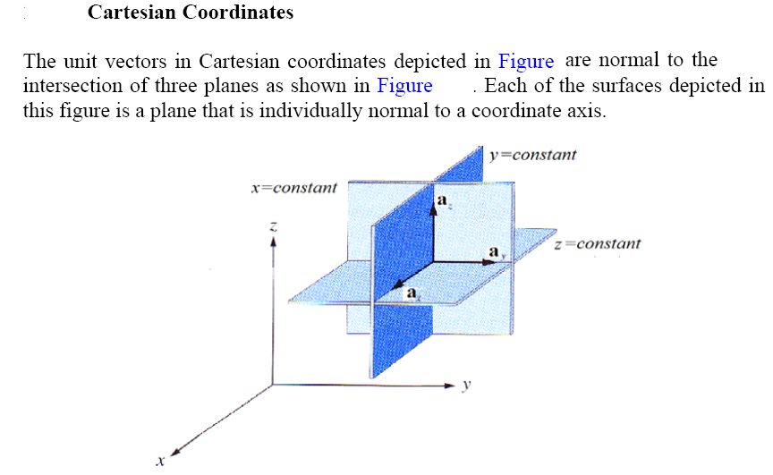

Slide 33
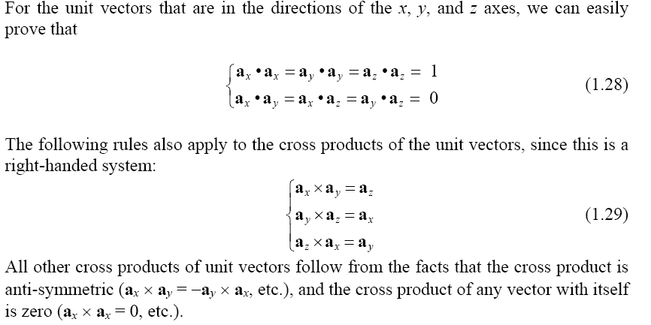

Slide 34
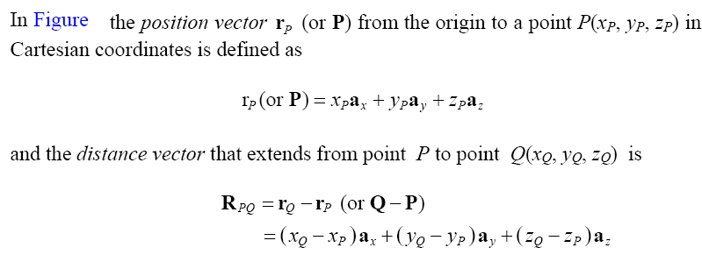
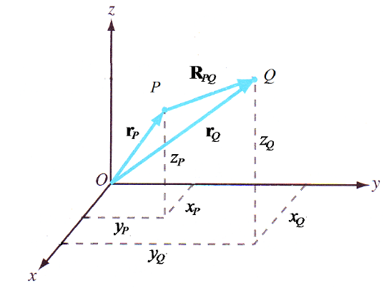

Slide 35
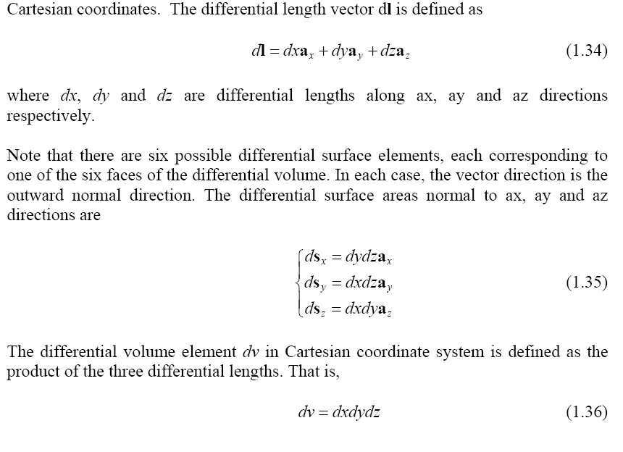

Slide 36
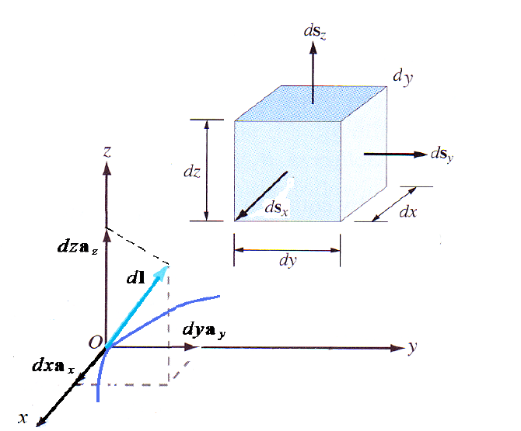

Slide 37
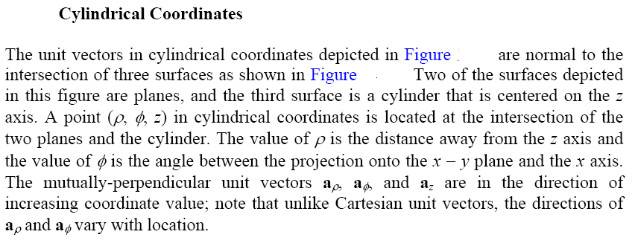

Slide 38
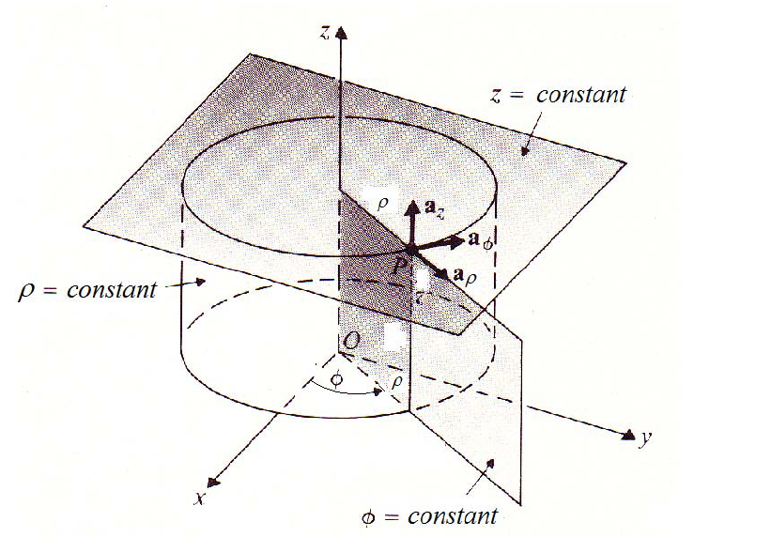

Slide 39
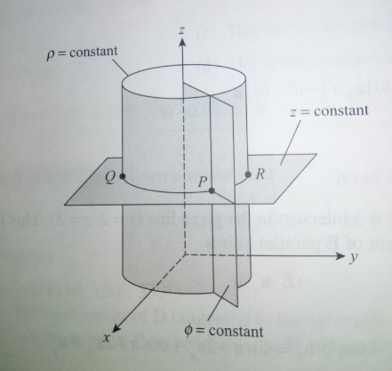

Slide 40
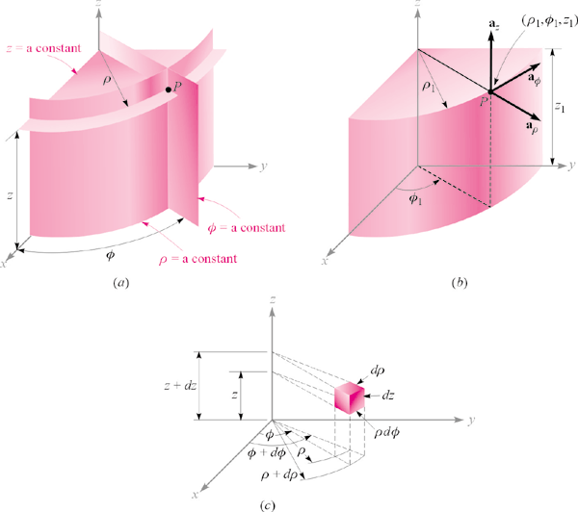
Circular Cylindrical Coordinate System
1 - Unit Vector
vary with
The coordinate φ
Since direction changes
2 – Dot Product

Slide 41
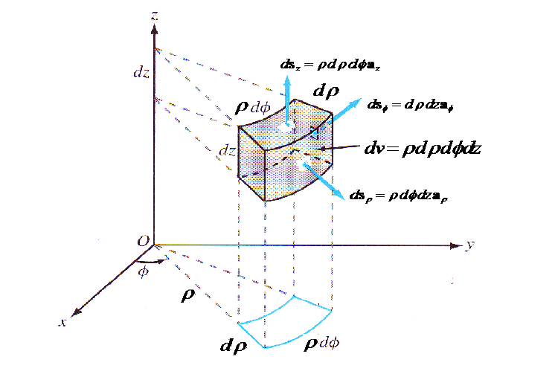

Slide 42
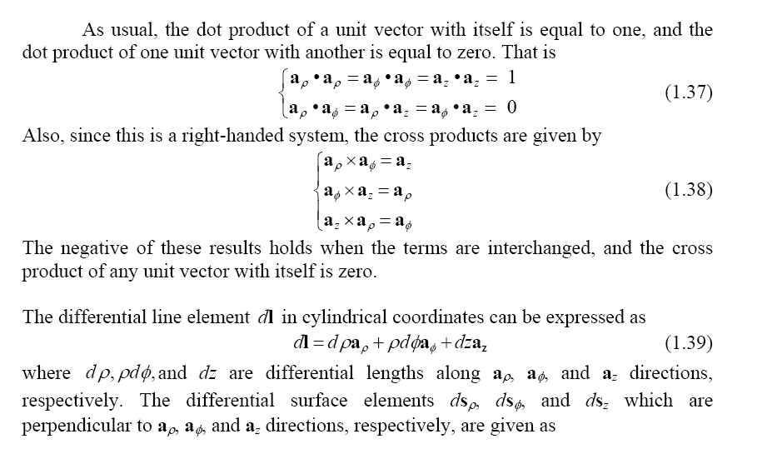

Slide 43
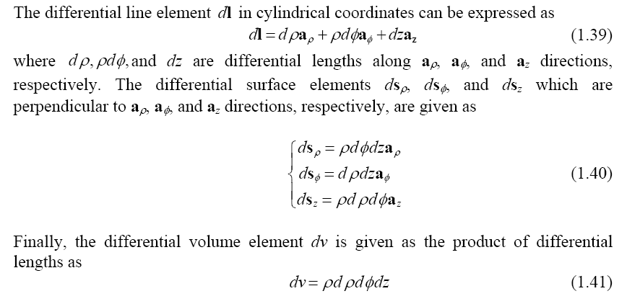

Slide 44
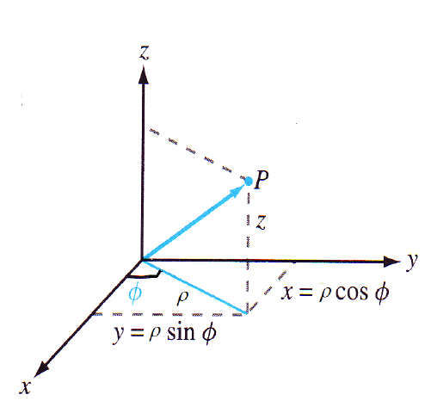
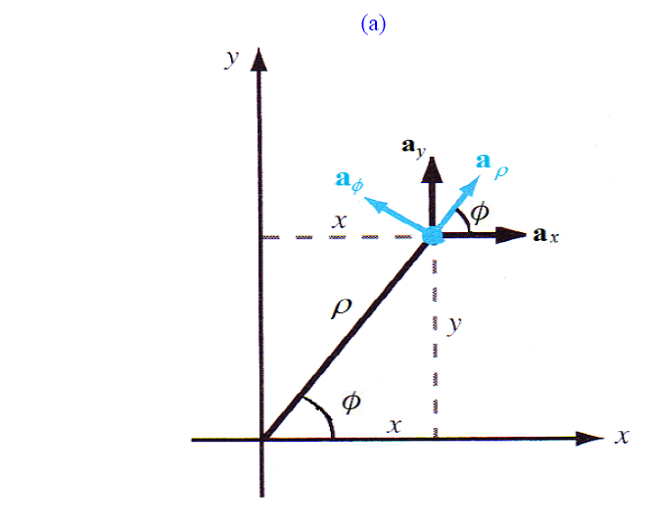

Slide 45
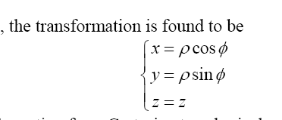
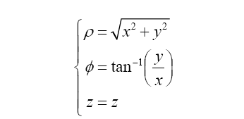

Slide 46
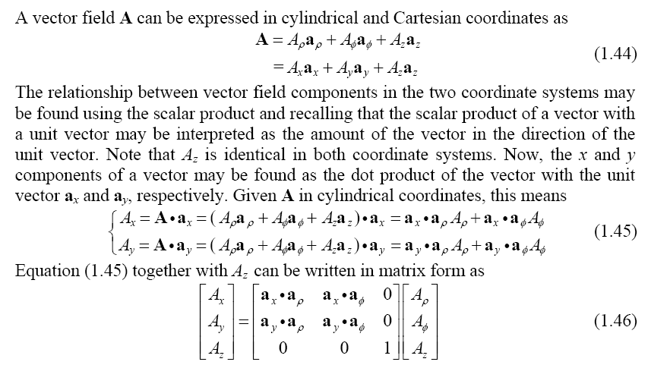

Slide 47
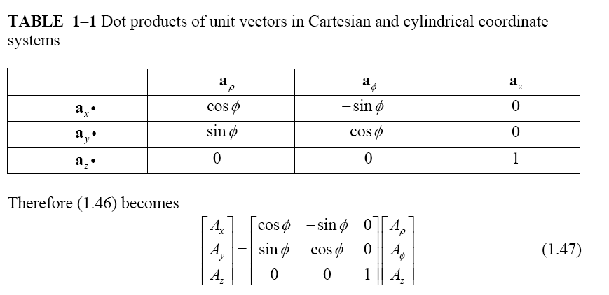

Slide 48
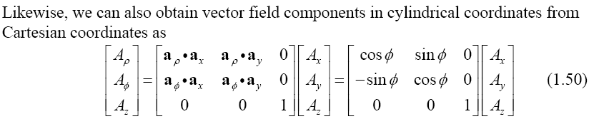

Slide 49
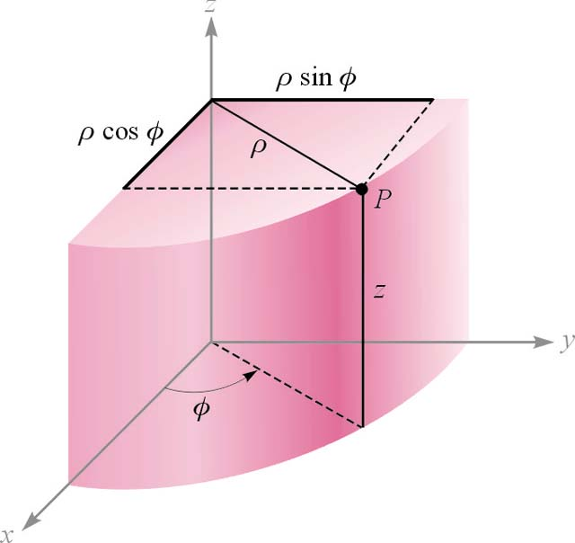
Circular Cylindrical Coordinate System
Dot Product

Slide 50
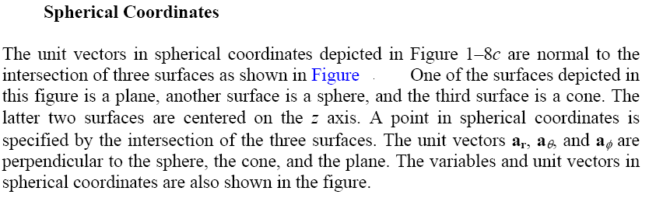
Spherical co-ordinate system

Slide 51
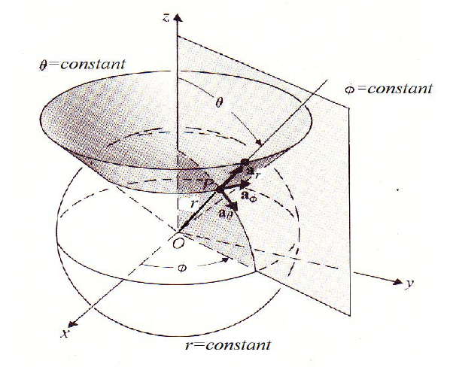

Slide 52
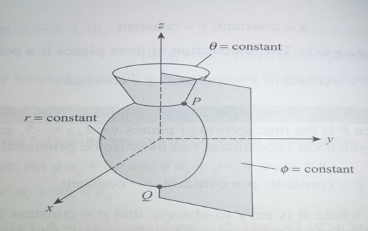

Slide 53
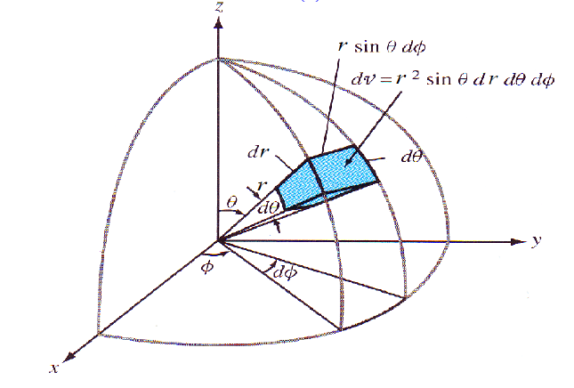

Slide 54
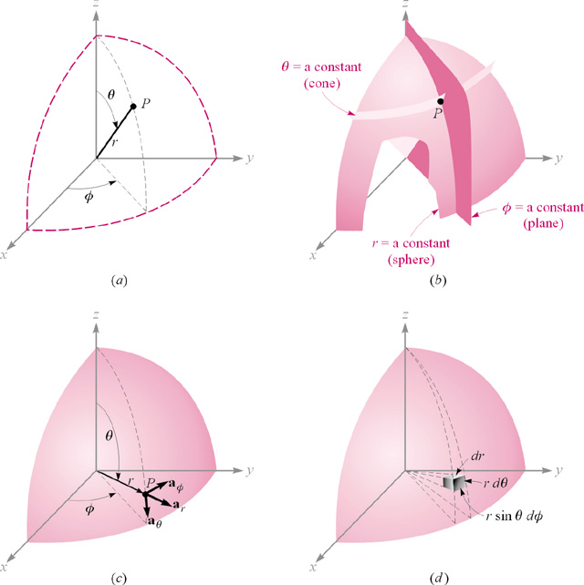
The Spherical Coordinate System

Slide 55
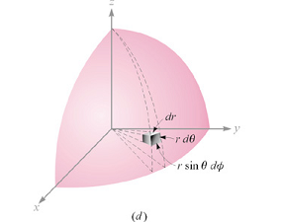
The Spherical Coordinate System

Slide 56
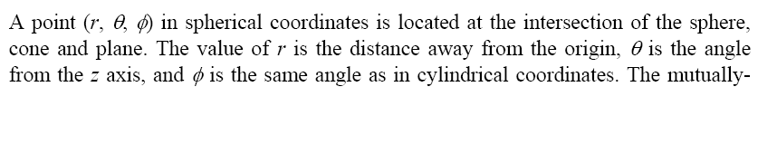
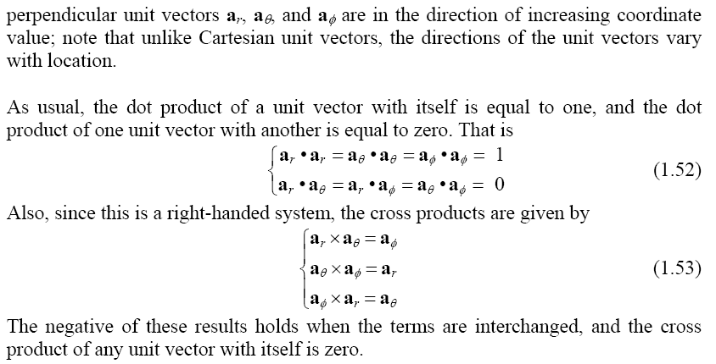

Slide 57
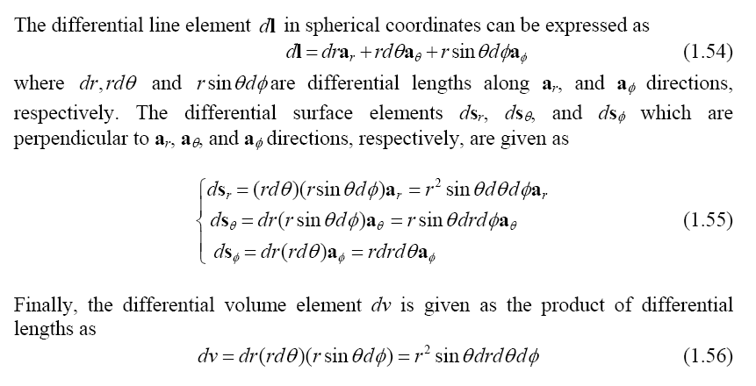

Slide 58
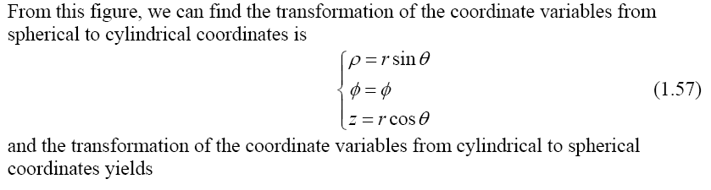
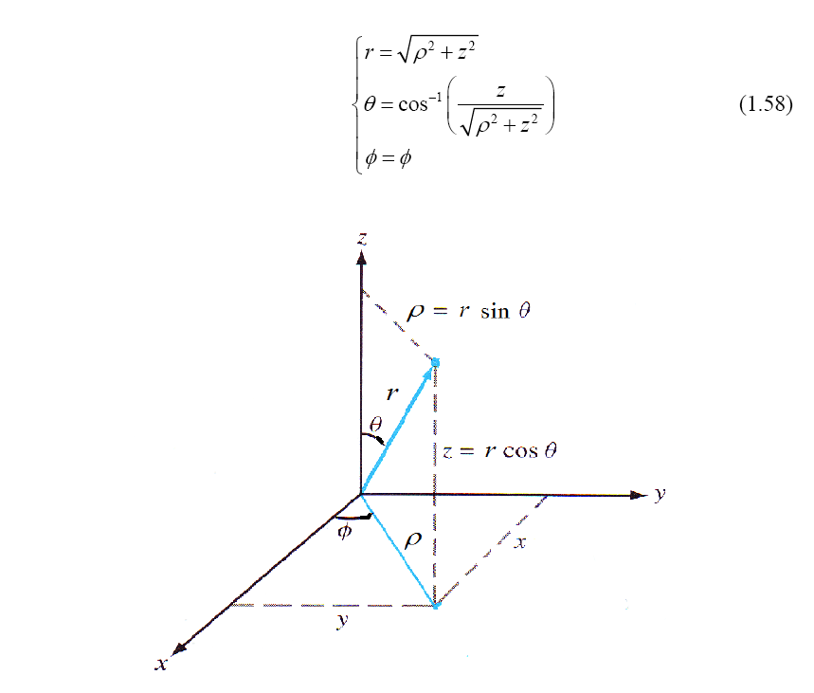

Slide 59
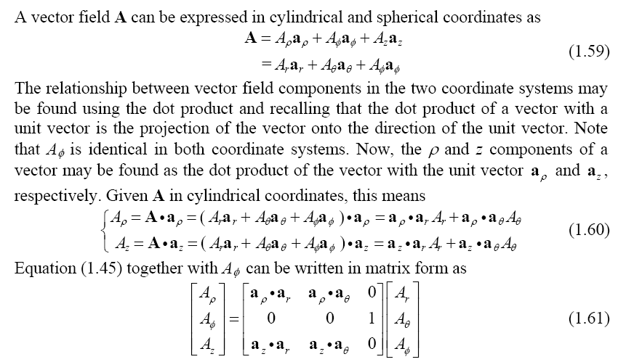

Slide 60
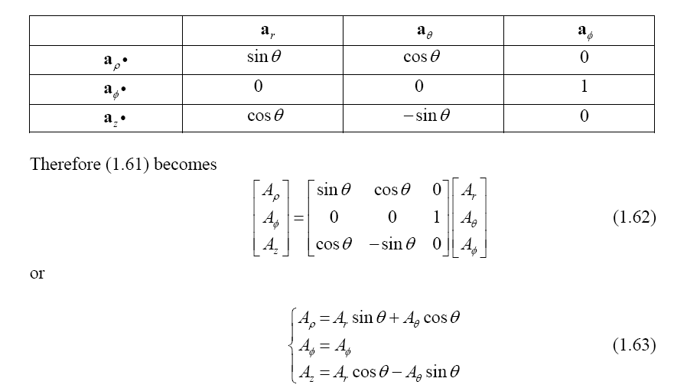

Slide 61
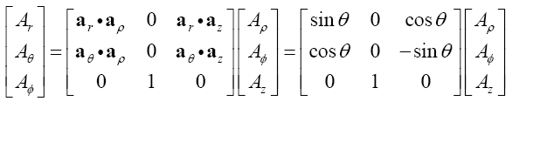
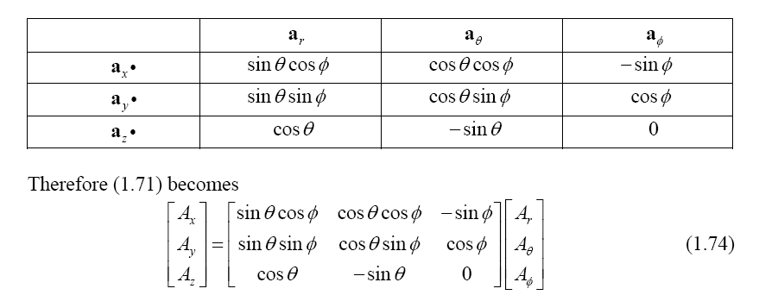

Slide 62
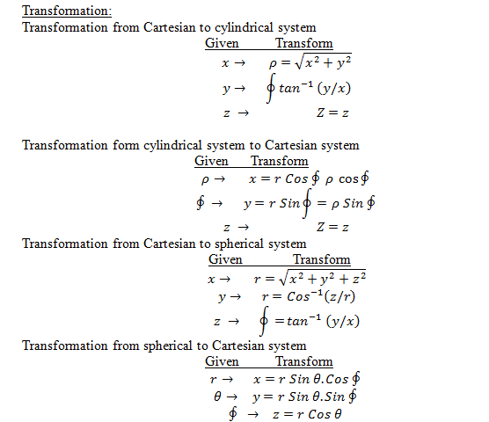

Slide 63
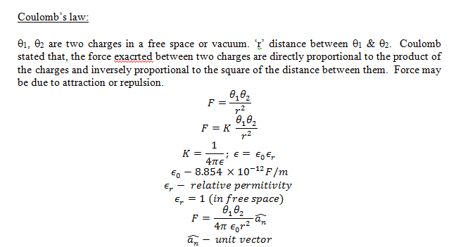

Slide 64


Slide 65


Slide 66


Slide 67



Slide 68


Slide 69



Slide 70


Slide 71


Slide 72


Slide 73


Slide 74
DIVERGENCE THEOREM
Thus, the Divergence Theorem states that:
  Under the given conditions, the flux of F
  across the boundary surface of E is equal
  to the triple integral of the divergence of F
  over E.

Slide 76

THE LINE INTEGRAL OF A VECTOR AROUND A CLOSED PATH IS EQUAL TO THE SURFACE INTEGRAL OF THE NORMAL COMPONENT OF ITS CURL OVER A CLOSED ATH.

Slide 77
Electrostatics
Electrostatics is the branch of electromagnetics dealing with the effects of electric charges at rest.
The fundamental law of electrostatics is Coulomb’s law.

Slide 78
Electric Charge
Electrical phenomena caused by friction are part of our everyday lives, and can be understood in terms of electrical charge.
The effects of electrical charge can be observed in the attraction/repulsion of various objects when “charged.”
Charge comes in two varieties called “positive” and “negative.”

Slide 79
Electric Charge
Objects carrying a net positive charge attract those carrying a net negative charge and repel those carrying a net positive charge.
Objects carrying a net negative charge attract those carrying a net positive charge and repel those carrying a net negative charge.
On an atomic scale, electrons are negatively charged and nuclei are positively charged.

Slide 80
Coulomb’s Law
Coulomb’s law is the “law of action” between charged bodies.
Coulomb’s law gives the electric force between two point charges in an otherwise empty universe.
A point charge is a charge that occupies a region of space which is negligibly small compared to the distance between the point charge and any other object.

Slide 81
Coulomb’s Law
Q₁
Q₂
Unit vector in
direction of R₁₂
Force due to Q₁
acting on Q₂

Slide 82
Coulomb’s Law
The force on Q₁ due to Q₂ is equal in magnitude but opposite in direction to the force on Q₂ due to Q₁.

Slide 83
Electric Field
Consider a point charge Q placed at the origin of a coordinate system in an otherwise empty universe.
A test charge Q_{t} brought near Q experiences a force:
Q_{t}
Q

Slide 84
Electric Field
The existence of the force on Q_{t} can be attributed to an electric field produced by Q.
The electric field produced by Q at a point in space can be defined as the force per unit charge acting on a test charge Q_{t} placed at that point.

Slide 85
Electric Field
The electric field describes the effect of a stationary charge on other charges and is an abstract “action-at-a-distance” concept, very similar to the concept of a gravity field.
The basic units of electric field are newtons per coulomb.
In practice, we usually use volts per meter.

Slide 86
Electric Field
For a point charge at the origin, the electric field at any point is given by

Slide 87
Electric Field
For a point charge located at a point P’ described by a position vector
the electric field at P is given by
P
Q
O

Slide 88
Electric Field
In electromagnetics, it is very popular to describe the source in terms of primed coordinates, and the observation point in terms of unprimed coordinates.
As we shall see, for continuous source distributions we shall need to integrate over the source coordinates.

Slide 89
Electric Field
Using the principal of superposition, the electric field at a point arising from multiple point charges may be evaluated as

Slide 90
Continuous Distributions of Charge
Charge can occur as
  point charges (C)
  volume charges (C/m³)
  surface charges (C/m²)
  line charges (C/m)
⇐ most general

Slide 92
Charge Densities
Volume charge density: when a charge is distributed evenly throughout a volume
  ρ = Q / V dq = ρ dV
Surface charge density: when a charge is distributed evenly over a surface area
  σ = Q / A dq = σ dA
Linear charge density: when a charge is distributed along a line
  λ = Q / dq = λ d

Slide 93
Continuous Distributions of Charge
Volume charge density
Q_{encl}
ΔV’

Slide 94
Continuous Distributions of Charge
Electric field due to volume charge density
dV’
P
Q_{encl}
V’

Slide 95
Electric Field Due to Volume Charge Density

Slide 96
Continuous Distributions of Charge
Surface charge density
Q_{encl}
ΔS’

Slide 97
Continuous Distributions of Charge
Electric field due to surface charge density
dS’
P
Q_{encl}
S’

Slide 98
Electric Field Due to Surface Charge Density

Slide 99
Continuous Distributions of Charge
Line charge density
ΔL’
Q_{encl}

Slide 100
Continuous Distributions of Charge
Electric field due to line charge density
ΔL’
Q_{encl}
P

Slide 101
Electric Field Due to Line Charge Density

Slide 102
Electrostatic Potential
An electric field is a force field.
If a body being acted on by a force is moved from one point to another, then work is done.
The concept of scalar electric potential provides a measure of the work done in moving charged bodies in an electrostatic field.

Slide 103
Electrostatic Potential
The work done in moving a test charge from one point to another in a region of electric field:
b
a
q

Slide 104
Electrostatic Potential
In evaluating line integrals, it is customary to take the dl in the direction of increasing coordinate value so that the manner in which the path of integration is traversed is unambiguously determined by the limits of integration.
b
a
x
3
5

Slide 105
Electrostatic Potential
The electrostatic field is conservative:
  The value of the line integral depends only on the end points and is independent of the path taken.
  The value of the line integral around any closed path is zero.
C

Slide 106
Electrostatic Potential
The work done per unit charge in moving a test charge from point a to point b is the electrostatic potential difference between the two points:
electrostatic potential difference
Units are volts.

Slide 107
Electrostatic Potential
Since the electrostatic field is conservative we can write

Slide 108
Electrostatic Potential
Thus the electrostatic potential V is a scalar field that is defined at every point in space.
In particular the value of the electrostatic potential at any point P is given by
reference point

Slide 109
Electrostatic Potential
The reference point (P₀) is where the potential is zero (analogous to ground in a circuit).
Often the reference is taken to be at infinity so that the potential of a point in space is defined as

Slide 110
Electrostatic Potential and Electric Field
The work done in moving a point charge from point a to point b can be written as

Slide 111
Electrostatic Potential and Electric Field
Along a short path of length Δl we have

Slide 112
Electrostatic Potential and Electric Field
Along an incremental path of length dl we have
Recall from the definition of directional derivative:

Slide 113
Electrostatic Potential and Electric Field
Thus:
the “del” or “nabla” operator

Slide 114

Electric field intensity at any point due to a uniformly charged wire.

Slide 115


Slide 116



Slide 117


Slide 118



Slide 119


Slide 120


Slide 121


Slide 122


Slide 123


Slide 124


Slide 125


Slide 126


Slide 127


Slide 128
Introduction to magnetic field:
Electric charge at rest produces an electric field called electrostatic field.
Electric charge in motion that is current produces magnetic field.
Magnetic flux:
Magnetic flux passing through any area.
the second equ. Is the gauss law for electric field.

Slide 129
The charge Q is the source of the lines of electric flux, these lines begins and terminate on positive and negative charge respectively. No source is found for lines of magnetic field. The magnetic flux lines are closed and do not terminate on magnetic charge. Gauss law for magnetic field is,
By divergence theorem
i.e The total magnetic flux passing through the closed path is equal to zero.

Slide 130
Magnetic force on moving charge:
A charged particle in motion in B is experienced by force.
F=Q(v*B)
F=QvB sinθ
Electric force on charge particle
F=QE+Q(v*B)
The force on current element
dF=dQ(v*B) since v=dl/dt and I=dQ/dt
F=BIL
Magnetic force:
F = BQV Sinθ - interms of charge Q (Lorentz force)
F =BIL Sinθ - Interms of current I.

Slide 131

d
P
Q

Slide 132
Magnetic torque:
When the current loop is placed parallel to a magnetic field force act on the loop and trend to rotate it. The product of tangential force and the radial distance at which it acts is called the torque.
Consider the rectangular loop
Carrying current I.
F
θ
F
l
Axis of rotation
b

Slide 133


Slide 134
FIVE ELECTROMAGNETIC PRINCIPLES
1.An electromotive force (EMF) will produce a current that is proportional to the conductivity of the
path. This is commonly known as Ohm’s law.
2. An electric current constitutes a magnetomotive force (MMF) that produces magnetic flux
proportional to the permeability of the path. This is often referred to as Ohm’s law for magnetic circuits.
3. A magnetic field will exert a force on a current-carrying conductor. This is the basis for motor action.
4. A conductor moving through a magnetic field will have an EMF induced in it.
Similarly, if a magnetic flux passing through a coil changes with time, an EMF will be induced in the coil.
This is Faraday’s law, which is the basis for generator action.
5. The polarity of the EMF induced in a coil will cause a current that will oppose any change in the
magnetic flux. This is known as Lenz’s law.

Slide 135



Motor Action (Electromagnetic Force)
Two magnets can be used to create a force.
A coil can be used to create an electromagnet that has magnetic flux
just like a permanent magnet.

Slide 136


Because current is flowing in the coils, they produce magnetic flux in the directions shown, which can be
determined by the right-hand rule.
There will thus be a force that will try to push the two coils apart. Since the force is created by the magnetic field of an electric coil, the force is called the electromagnetic force.
Figure shows two views of parallel conductors that are carrying currents in opposite directions, and magnetic fluxes produced by these currents.
The current in a conductor and the magnetic field around the conductor are related by the right-hand rule.
The currents are in opposite directions, so are the fluxes.
The conductor on the left side has magnetic flux surrounding it in the clockwise direction, while the right conductor has flux surrounding it in the counterclockwise direction.
demonstration

Slide 137


Left-Hand rule
From electromagnetic field theory: the flux (or flux density), the current, and the force are mutually perpendicular, just like the XYZ axes of the Cartesian coordinate system.
They can be related by a left-hand rule: the index finger shows the direction of magnetic flux, and the middle finger (when pointing perpendicular to the index finger) shows the direction of the current.
The outwardly extending thumb, then, points in the direction of the electromagnetic force.
When the flux and current are perpendicular the force magnitude is given by
where B is the flux density, I is the current, and F is the induced force.

Slide 138


If the flux and current intersect at an angle greater than zero but less than 90° , there will still be a force, but it will be diminished.
In particular, the force will be determined by the components of flux and current that are mutually perpendicular.
Figure shows a conductor of length I that is carrying current in the presence of an external magnetic field.
In this case, the current is not perpendicular to the flux. The angle between them is alpha, so the angle beta is equal to 90° - alpha.
The angle beta is referred to as the skew angle.
We could split the current into two components, one that is perpendicular to the flux and one that is in the same direction as the
flux. The component of the current that is perpendicular to the flux is I sin(alpha) or l cos(beta).
Thus, the force on the conductor is:

Slide 139


A simple linear motor
A conductor (called the armature) is free to move along a set of rails.
Current is applied so as to flow down the left rail across the armature, and back on the right rail.
Due to the flown current, a magnetic field is established in the loop bounded by the source, the rails, and the armature.
The current in both rails and the armature causes magnetic flux between the rail in the same direction.
There is no rail current beyond the armature, so the flux density is lower on the far side of the armature and there is a force on the armature that propels it down the rails.
The magnetic flux and the current are perpendicular.

Slide 140






A linear generator
Voltage is generated in the coils by either
rotating the coils through a magnetic field or
by rotating magnetic poles past stationary
windings.
A linear generator has two conducting rails
and a movable, conducting cross piece,
the armature.
If a conductor cuts magnetic flux then a voltage
is induced in it.
The generator is operated by physically pulling
the armature down the rails at some velocity, v.
X is the distance of the armature from the left end, then the area of the window created by the rails
and the armature is
Flux passing through the window is:
The voltage generated as a function of the changing
in time flux:

Slide 141



In this case there is only one turn:
We can use the right-hand generator rule to determine the direction of induced EMF in a conductor.
The voltage, the flux, and the velocity are mutually perpendicular.
The right-hand rule: the thumb indicates the direction of velocity, the index finger
indicates the direction of magnetic flux, and the middle finger the direction of the induced EMF.
As in the case of the linear motor, the velocity might not be perpendicular to the flux.
If alpha is the angle between the velocity and the flux, then we take the component of velocity that is
perpendicular to the flux to find the voltage:

